Slide 1
A* SEARCH ALGORITHM
USING THREADS
Made by :
Bilal Ahmed 18k-1144
Abdullah abro 18K-1126
wajahat ali 18k-0363

Slide 2
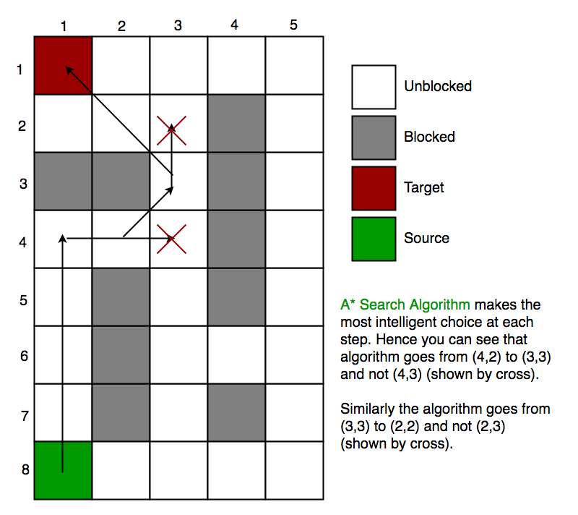
A* Search Algorithm
A* Search algorithm is one of the best and popular technique used in path-finding and graph traversals.
Unlike other traversal techniques, it has “brains”. What it means is that it is really a smart algorithm which separates it from the other conventional algorithms.

Slide 3
A* Search Algorithm
ALGORITHM:
Add start node to list
For all the neighbouring nodes, find the least cost F node
Switch to the closed list
For 8 nodes adjacent to the current node
If the node is not reachable, ignore it. Else
If the node is not on the open list, move it to the open list and calculate f, g, h.
If the node is on the open list, check if the path it offers is less than the current path and change to it if it does so.
Stop working when
You find the destination
You cannot find the destination going through all possible points

Slide 4
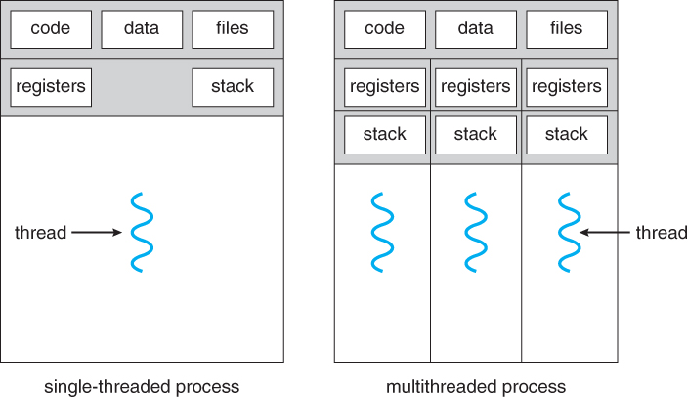
Threads
A thread is a basic unit of CPU utilization, consisting of a program counter, a stack, and a set of registers, ( and a thread ID. )
Threads are often described as light-weight processes. They can work like two or more processes sharing the same address space i.e. they will work independently like processes but can share the same global variables

Slide 5
Problem Statement
To Implement A* search Algorithm and concept of threads simultaneously to make a program where shortest distance is calculated with the help of threads creating and threads joining.

Slide 6
Procedure and Method/implementation (You applied)
Our project is implemented using C.
Additional Libraries Used were:
Pthread.h
math.h
The procedure of use is as follows:
Set Rows and Columns
In the array MAZE, set 0 for traversable path, 1 for blocked path.
Compile The Code -> gcc -o proj proj.c -lpthread -lm

Slide 7
Project Result
As a result of our efforts, The shortest path from the grid is calculated and displayed.
It is revealed by the experimental results that multithreading is a viable approach for parallel A* heuristic search. For instance, it has been found that the parallel multithreaded A* heuristic search algorithm, in particular, outperforms the sequential approach in terms of time complexity and speedup.
The time complexity of the parallel multithreaded A* algorithm becomes O(βk /t). This is better than the time complexity of the sequential A* algorithm, which is O(βk ).
Given that β is the branching factor, k is the depth of the shallowest solution and t is the number of threads

Slide 8
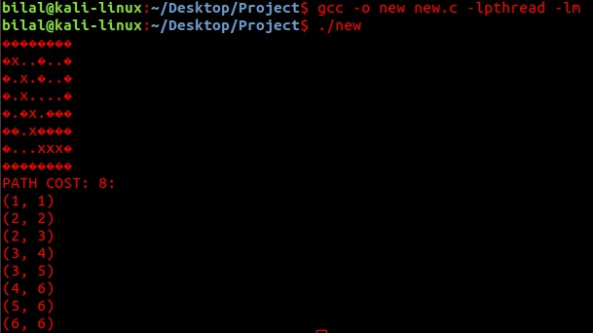
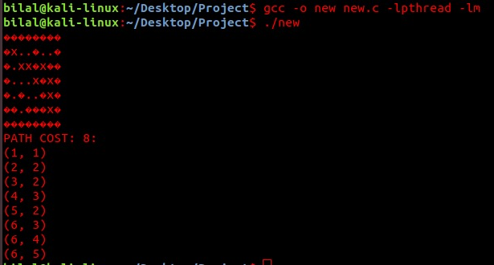
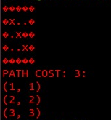
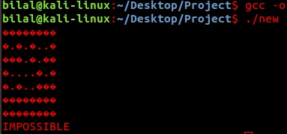
Screenshots

Slide 9
References
GeeksForGeeks
Cs.uic.edu
http://citeseerx.ist.psu.edu/viewdoc/download?doi=10.1.1.852.9544&rep=rep1&type=pdf
Youtube (A* Search Algorithm – Computerphile)
Lab Manuals

Slide 10
THANK YOU

